Slide 1

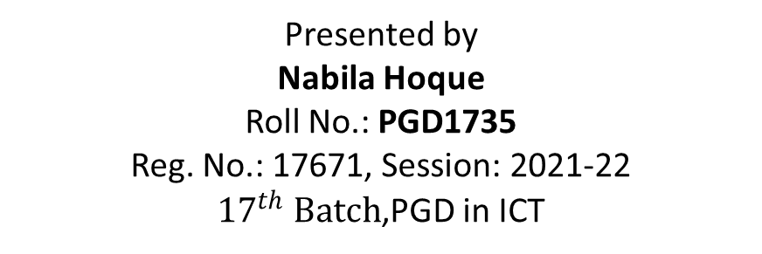
ONUKOLPO: E-COMMERCE MANAGEMENT SYSTEM FOR UNPRIVILEGED WOMEN
Presented by
Nabila Hoque
Roll No.: PGD1735
Reg. No.: 17671, Session: 2021-22
${17}^{th} Batch$,PGD in ICT
Supervisor
Prof. Dr. Md. Rakib Hassan
Co-Supervisor
Prof. Muhammad Mustagis Billah
Department of Computer Science and Mathematics
Bangladesh Agricultural University
Mymensingh-2202

Slide 2
Contents
Justification
Objectives
Existing works
Materials and Methods
Results And Discussion
Summary and conclusions
References
Acknowledgements

Slide 3
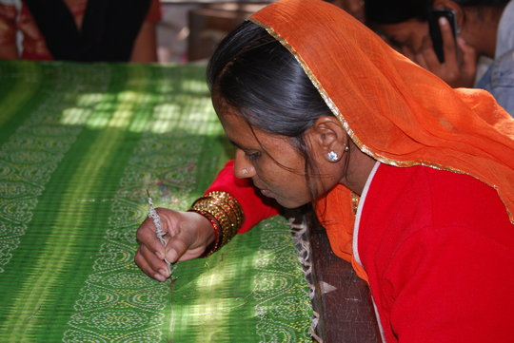
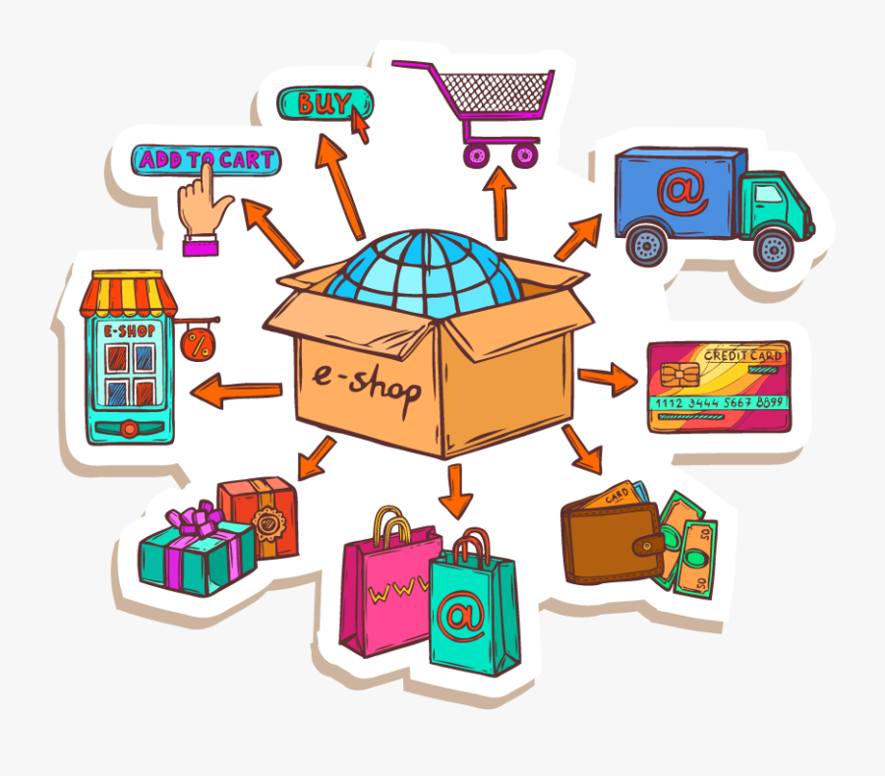
Justification
In our country, a greater portion of women can’t do jobs after managing their household chores. But they make different hand-made items that are actually popular, and people love to buy those hand-made items.
An E-commerce system can help us reach out to our potential clients and gives our business good exposure. People can purchase preferred things whenever they want with the aid of an e-commerce website.
During the Covid period, local handmade products businesses were hampered a lot. If a mobile-friendly website can be built for them, then people all over the world will buy their items.
Now-a-days, individuals prefer using an online shopping cart when purchasing gifts for their family and friends. We can file a complaint in the "goods return" area if our ordered item never arrives or arrives late. We can also add items to our "wishlist" on an e-commerce website and purchase them at a later time.
Fig 1.1: Women empowerment
Fig 1.2: Online shopping
Notes:
Some of them make monipuri Shari or Jamalpuri Bedsheet etc but these items are only available in specific places only.
these products can be bought worldwide and we can get international currency also by exporting these items. There are many e-commerce website which is currently available but the main problem is this available websites are not mobile friendly for the sellers.

Slide 4
Objectives
1. To make an easy graphical user interface system so that seller and buyer can easily access to the website
2. To encourage local sellers to sell internationally with the help of Onukolpo website

Slide 5
Existing Works
Website Name | Amenities/Unique Sides | Drawbacks
www.naaptol.com | images in content easy navigation discount offer | camouflaged information on the home page
www.yepme.com | Easy registration & Navigation Easy understanding of the information fastest downloading of the images | Content ease of use use of Multilanguage[1]
www.snapdeal.com | easy registration no misleading link no orphan pages no broken links aesthetic appeal | use of Multilanguage inadequate company information irrelevant product information[2]
www.jabong.com | content information is good adequate images and text size Product information are not complex | use of Multilanguage inadequate company information irrelevant product information

Slide 6
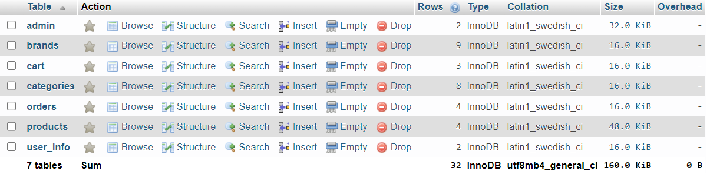
Materials and Methods
Onukolpo website
Customer
(User_info)
Admin
Hardwares
Computer
Softwares & Languages
XAMPP
Laptop
HTML,CSS,Bootstrap, Javascript,PHP
Categories
+
Brands
Cart
Orders
Products
Fig.3.1 MySQL Tables of Onukolpo website
Experimental period: June-September, 2022
Easy Graphical User Interphase based website
Fig. 3.2 Database SQL Tables

Slide 7
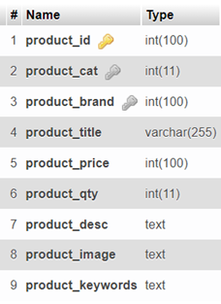
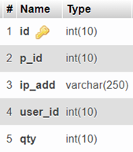
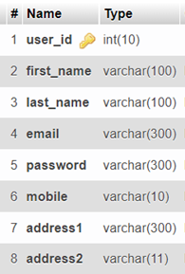
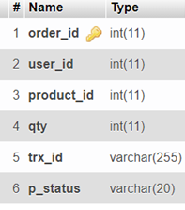
Materials and Methods
Table 1: Database SQL Tables
admin
brands
categories
cart
products
user_info
orders
Foreign keys are used in products table where brands maintain their ‘brands_id’ and categories maintain their ‘cat_id’.

Slide 8
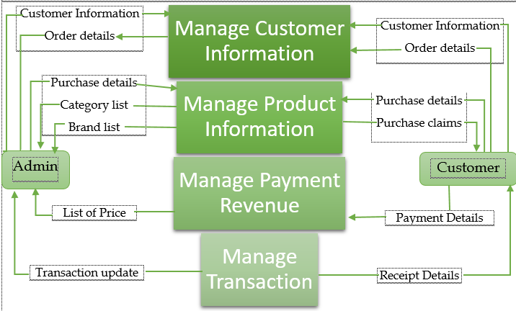
Materials and Methods
Onukolpo
E-commerce website
Admin
Customer
Product Details
Price details
Customer Info
Ordered Items
Customer Info
Purchase and order details
Payment Info
Fig. 3.3 Data flow diagram of Onukolpo Website

Slide 9

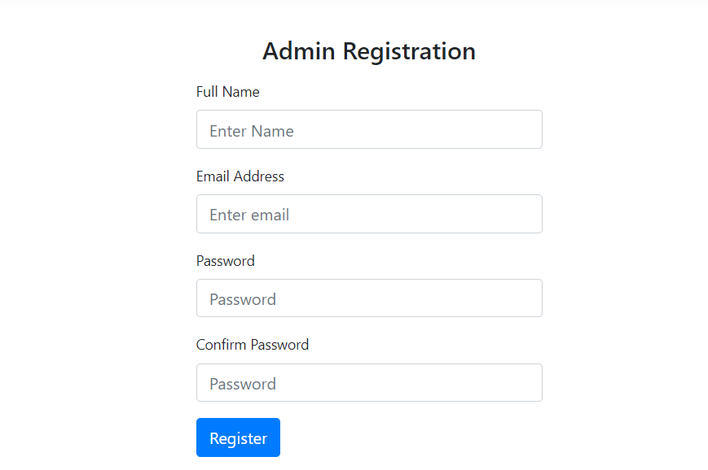
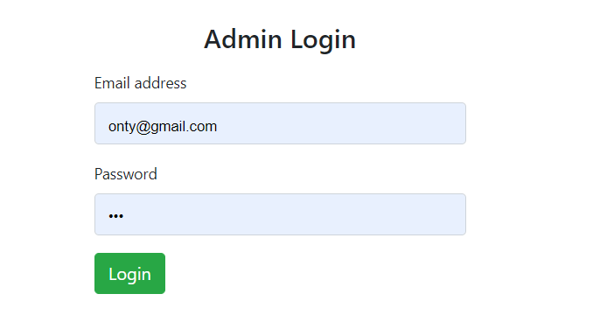
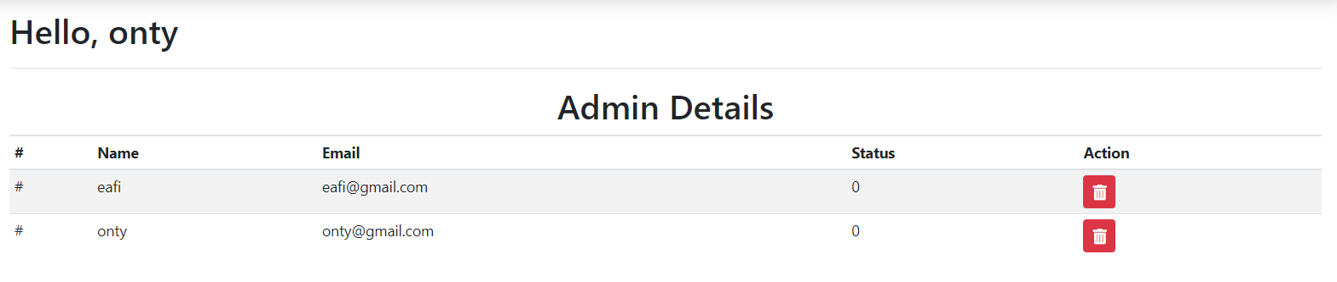
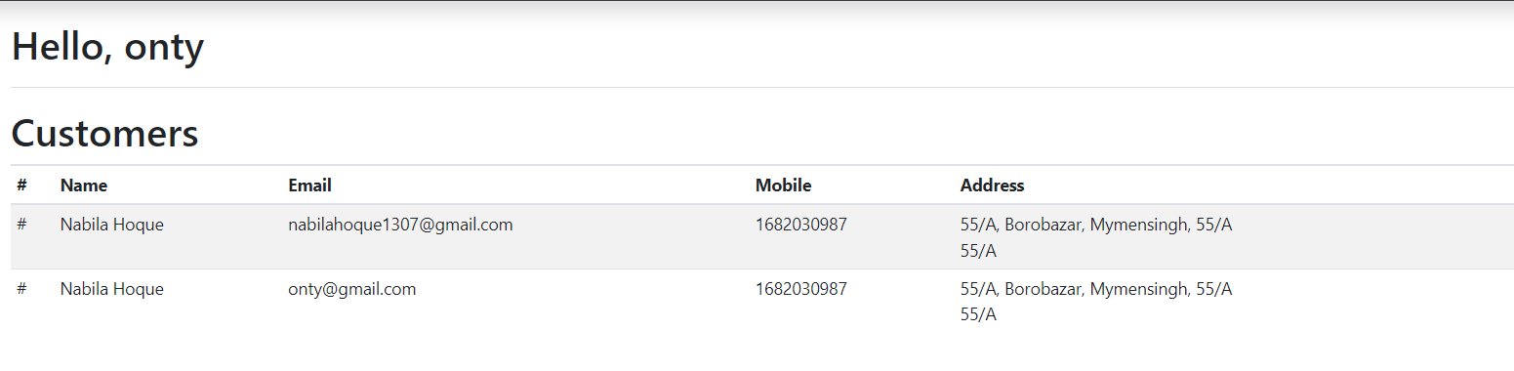
Admin view
Fig 4.1 Admin Login Page
Fig 4.2. Admin registration page
Fig 4.3 Admin Dashboard
Fig. 4.4 Customers Details Page(Admin view)

Slide 10
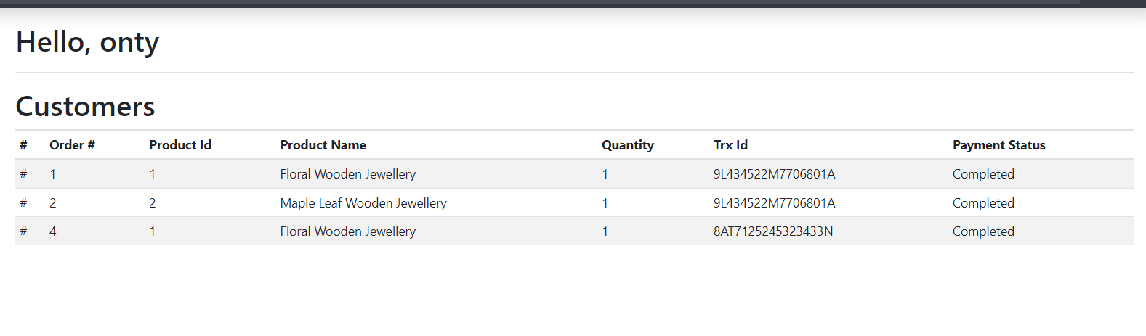
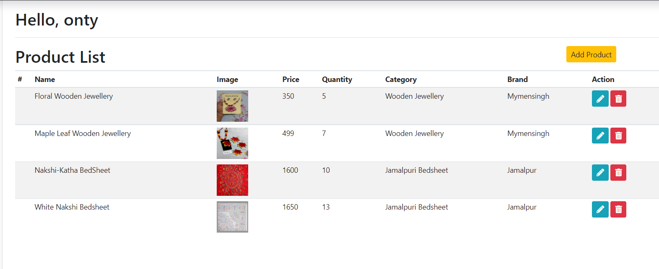
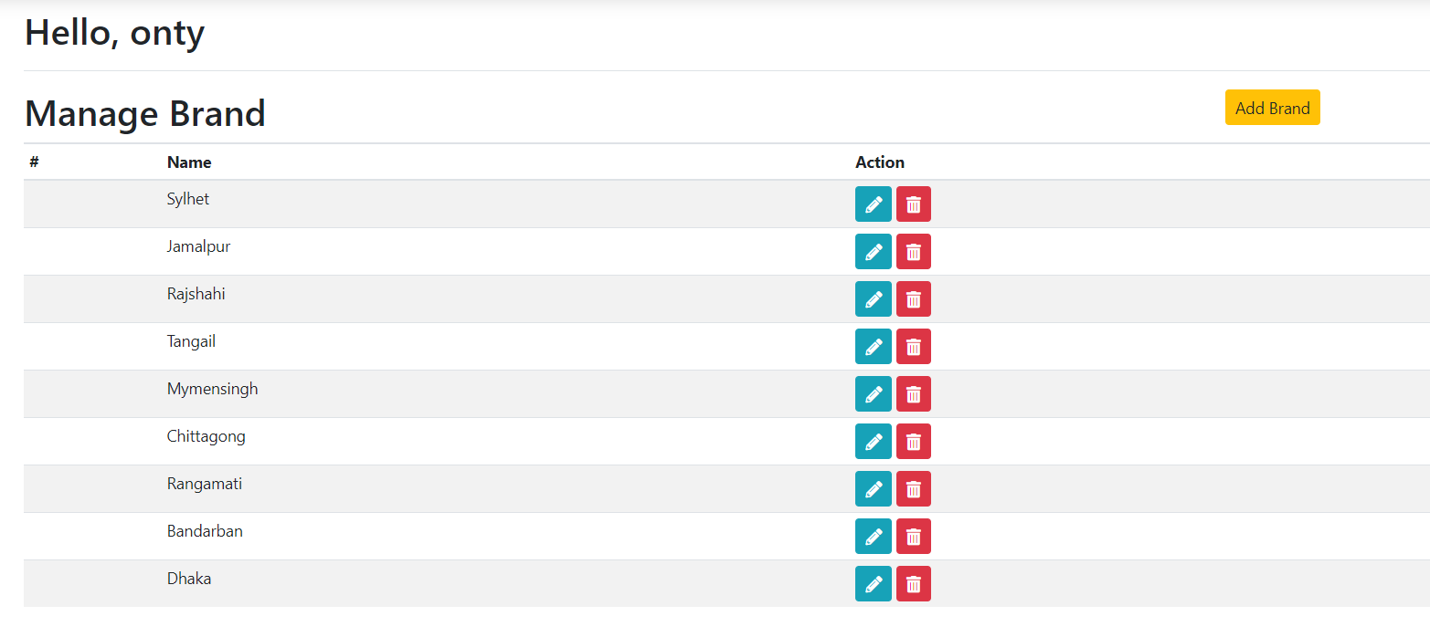
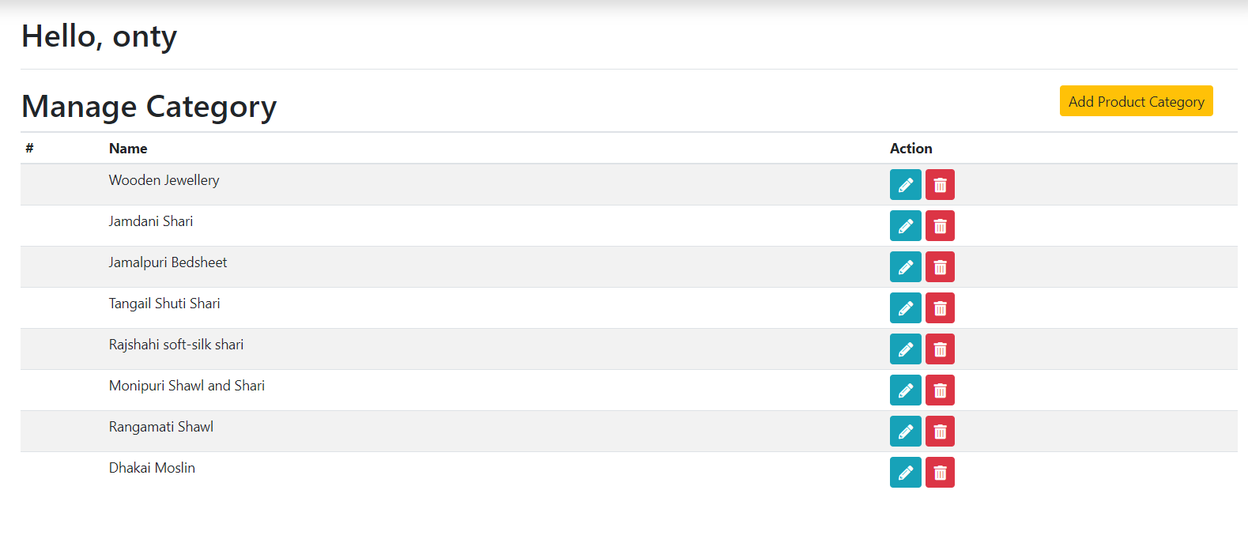
Admin view
Fig. 4.5 Order Completion page
Fig. 4.6 Products Page
Fig. 4.7 Brands Page
Fig. 4.8 Categories Page

Slide 11
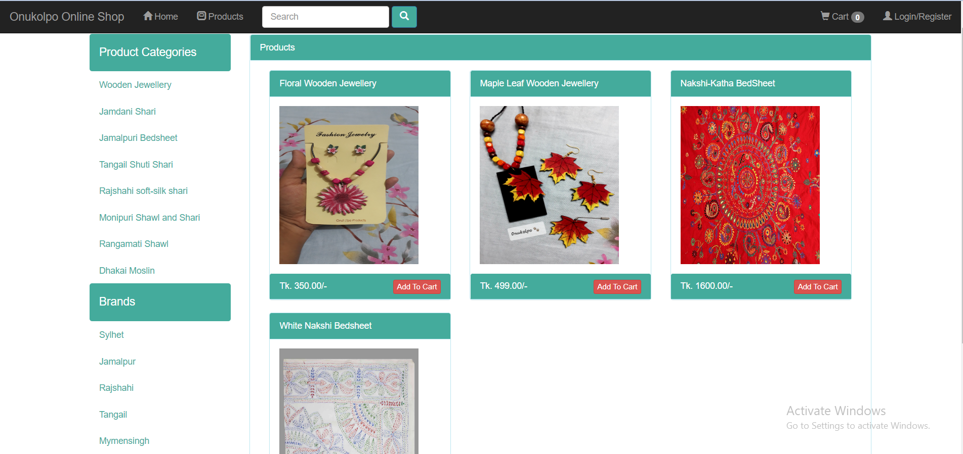
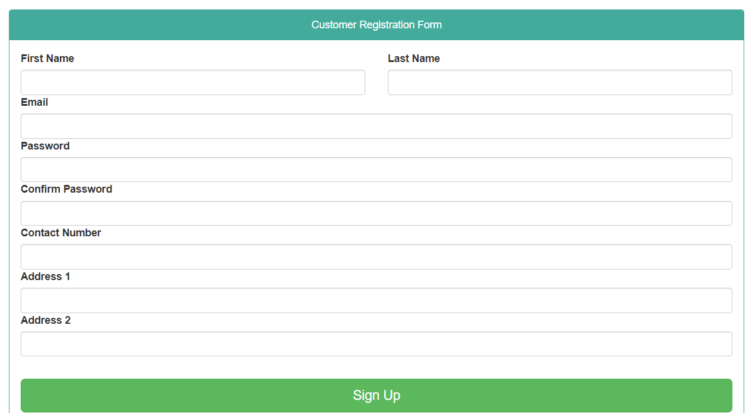
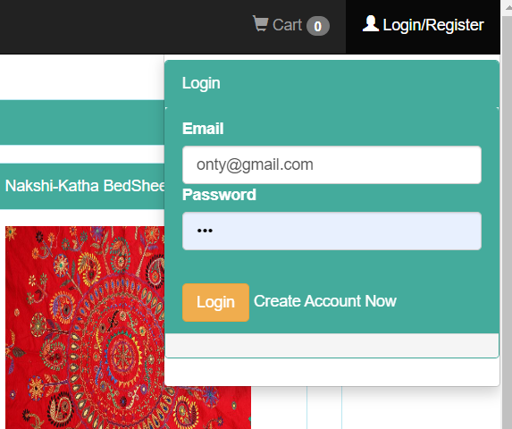
Customers view point
Fig. 4.2.1. Customers view of the front page
Fig. 4.2.2. Customer registration page
Fig. 4.2.3. Customer log in portal (pop-up view)

Slide 12
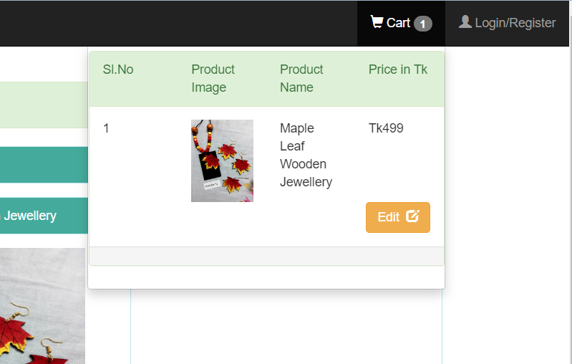
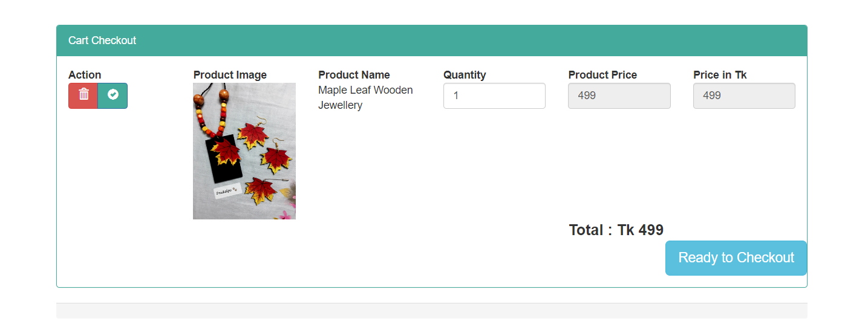
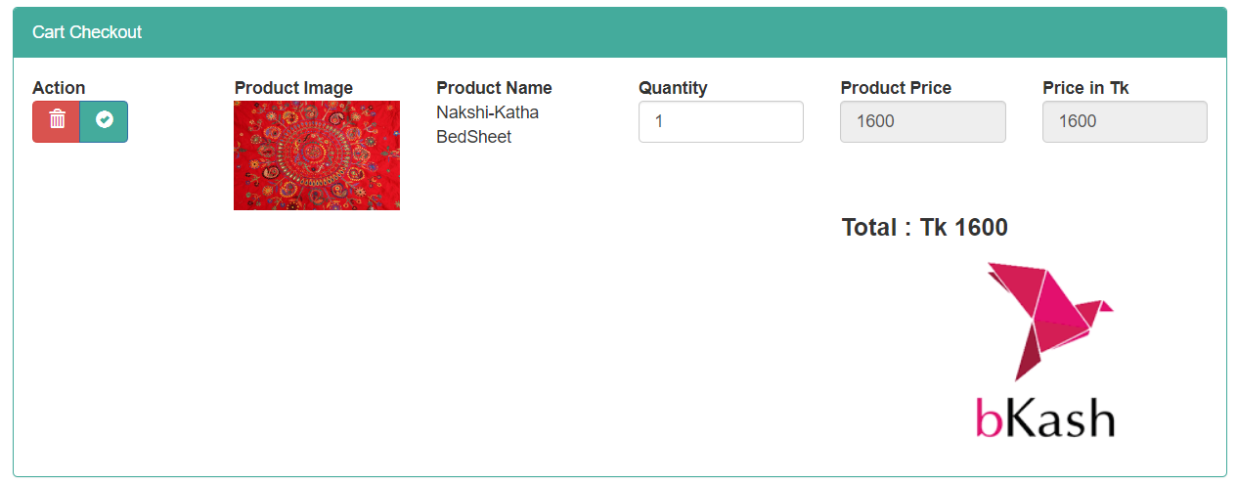
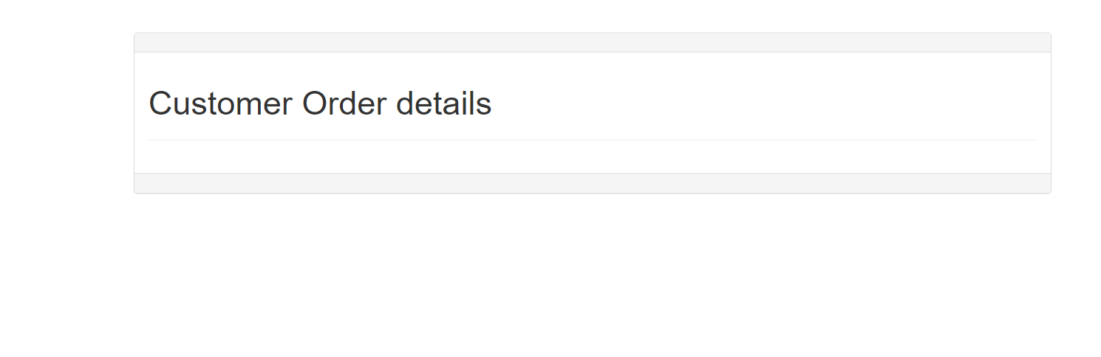
Customers view point
Fig. 4.2.4. Customer Cart page
Fig. 4.2.4. Customer Cart Page (Pop-up view)
Fig. 4.2.6. Customer order details
Fig. 4.2.5. Customer Check-out page (with BKASH option)

Slide 13
Summary & Conclusion
In Onukolpo website, easy graphical user interface has used for admins and customers user preference.
As this website is mobile friendly, so sellers can also easily understand how to upload their products and set their prices.
Buyers can get their preferable products at a cheaper rate also because there is no middle man in here.
Further work is going on to make it secure by purchasing an SSL certificate where a “Secure” button will show up next to the URL which will make the website more secure and trustworthy.

Slide 14
References
[1] M. Du Toit and C. Bothma, "Evaluating the usability of an academic marketing department's website from a marketing student's perspective," International Retail and Marketing Review, vol. 5, no. 1, pp. 25-37, 2009.
[2] V. McKinney, K. Yoon, and F. M. Zahedi, "The measurement of web-customer satisfaction: An expectation and disconfirmation approach," Information systems research, vol. 13, no. 3, pp. 296-315, 2002.

Slide 15
Acknowledgements
At first, I am grateful to the Almighty Allah
Prof. Dr. Md. Rakib Hassan, Department of Computer Science and Mathematics, Bangladesh Agricultural University
Prof. Muhammad Mustagis Billah, Department of Computer Science and Mathematics, Bangladesh Agricultural University
Other honorable teachers of the Department of Computer Science and Mathematics
My friends and well wishers
Laboratory staff

Slide 16


